Slide 1
Understanding the Genetic Underpinnings of Income
Baranzini Lab Journal Club
Original Manuscript: Kweon, H., Burik, C. A. P., Ning, Y., Ahlskog, R., Xia, C., Abner, E., et al. (2025). Associations between common genetic variants and income provide insights about the socio-economic health gradient. Nat. Hum. Behav., 1–12.
Presenter: Wanjun Gu

Slide 2
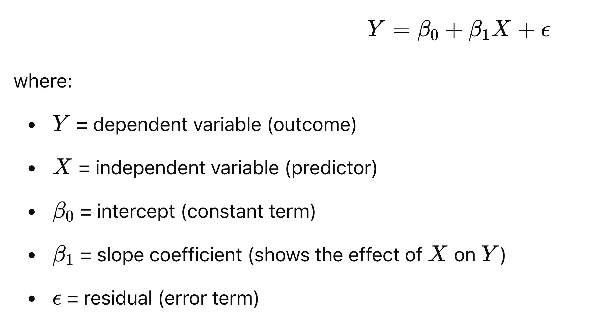
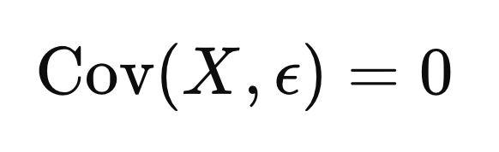
The Statistical Model of Genome-Wide Association Studies (GWAS)
Linear correlation
Assuming
If residual is somehow correlated with the independent variable, then additional covariates should be included in the model.
Notes:
Simple Explanation: The figure shows how many connections (edges) and elements (nodes) are in different parts of the interactome, which is a network of protein interactions. The largest component is from the STRING database, followed by the OTAR dataset. Smaller contributions come from IntAct, Reactome, and SIGNOR, showing how these sources combine to form a comprehensive network.

Slide 3
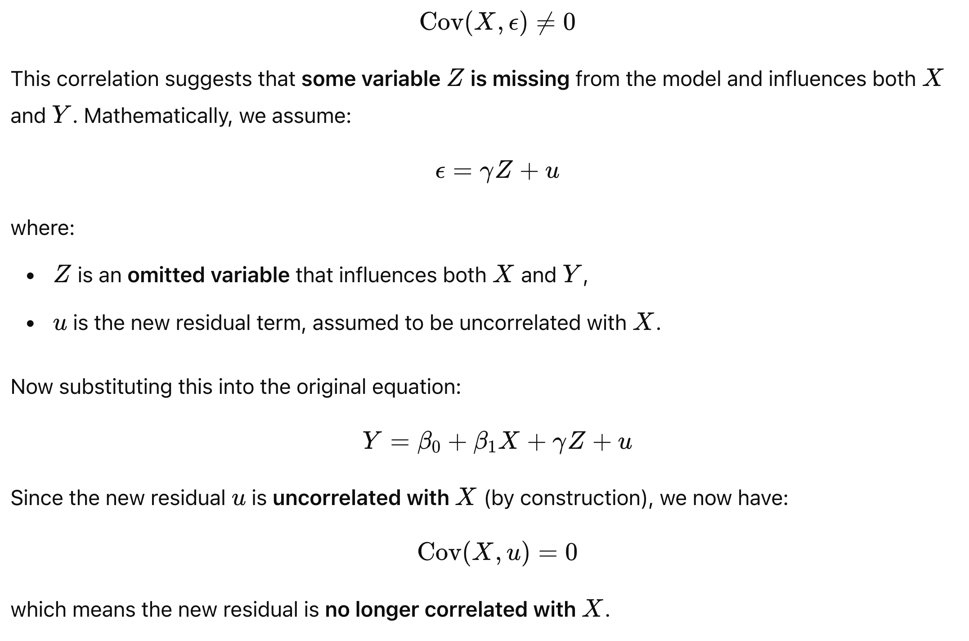
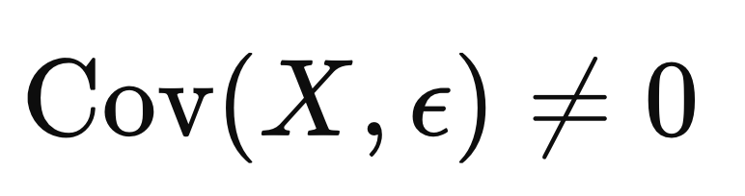
The Statistical Model of Genome-Wide Association Studies (GWAS)
If we observe
Then
Notes:
Simple Explanation: The figure shows how many connections (edges) and elements (nodes) are in different parts of the interactome, which is a network of protein interactions. The largest component is from the STRING database, followed by the OTAR dataset. Smaller contributions come from IntAct, Reactome, and SIGNOR, showing how these sources combine to form a comprehensive network.

Slide 4
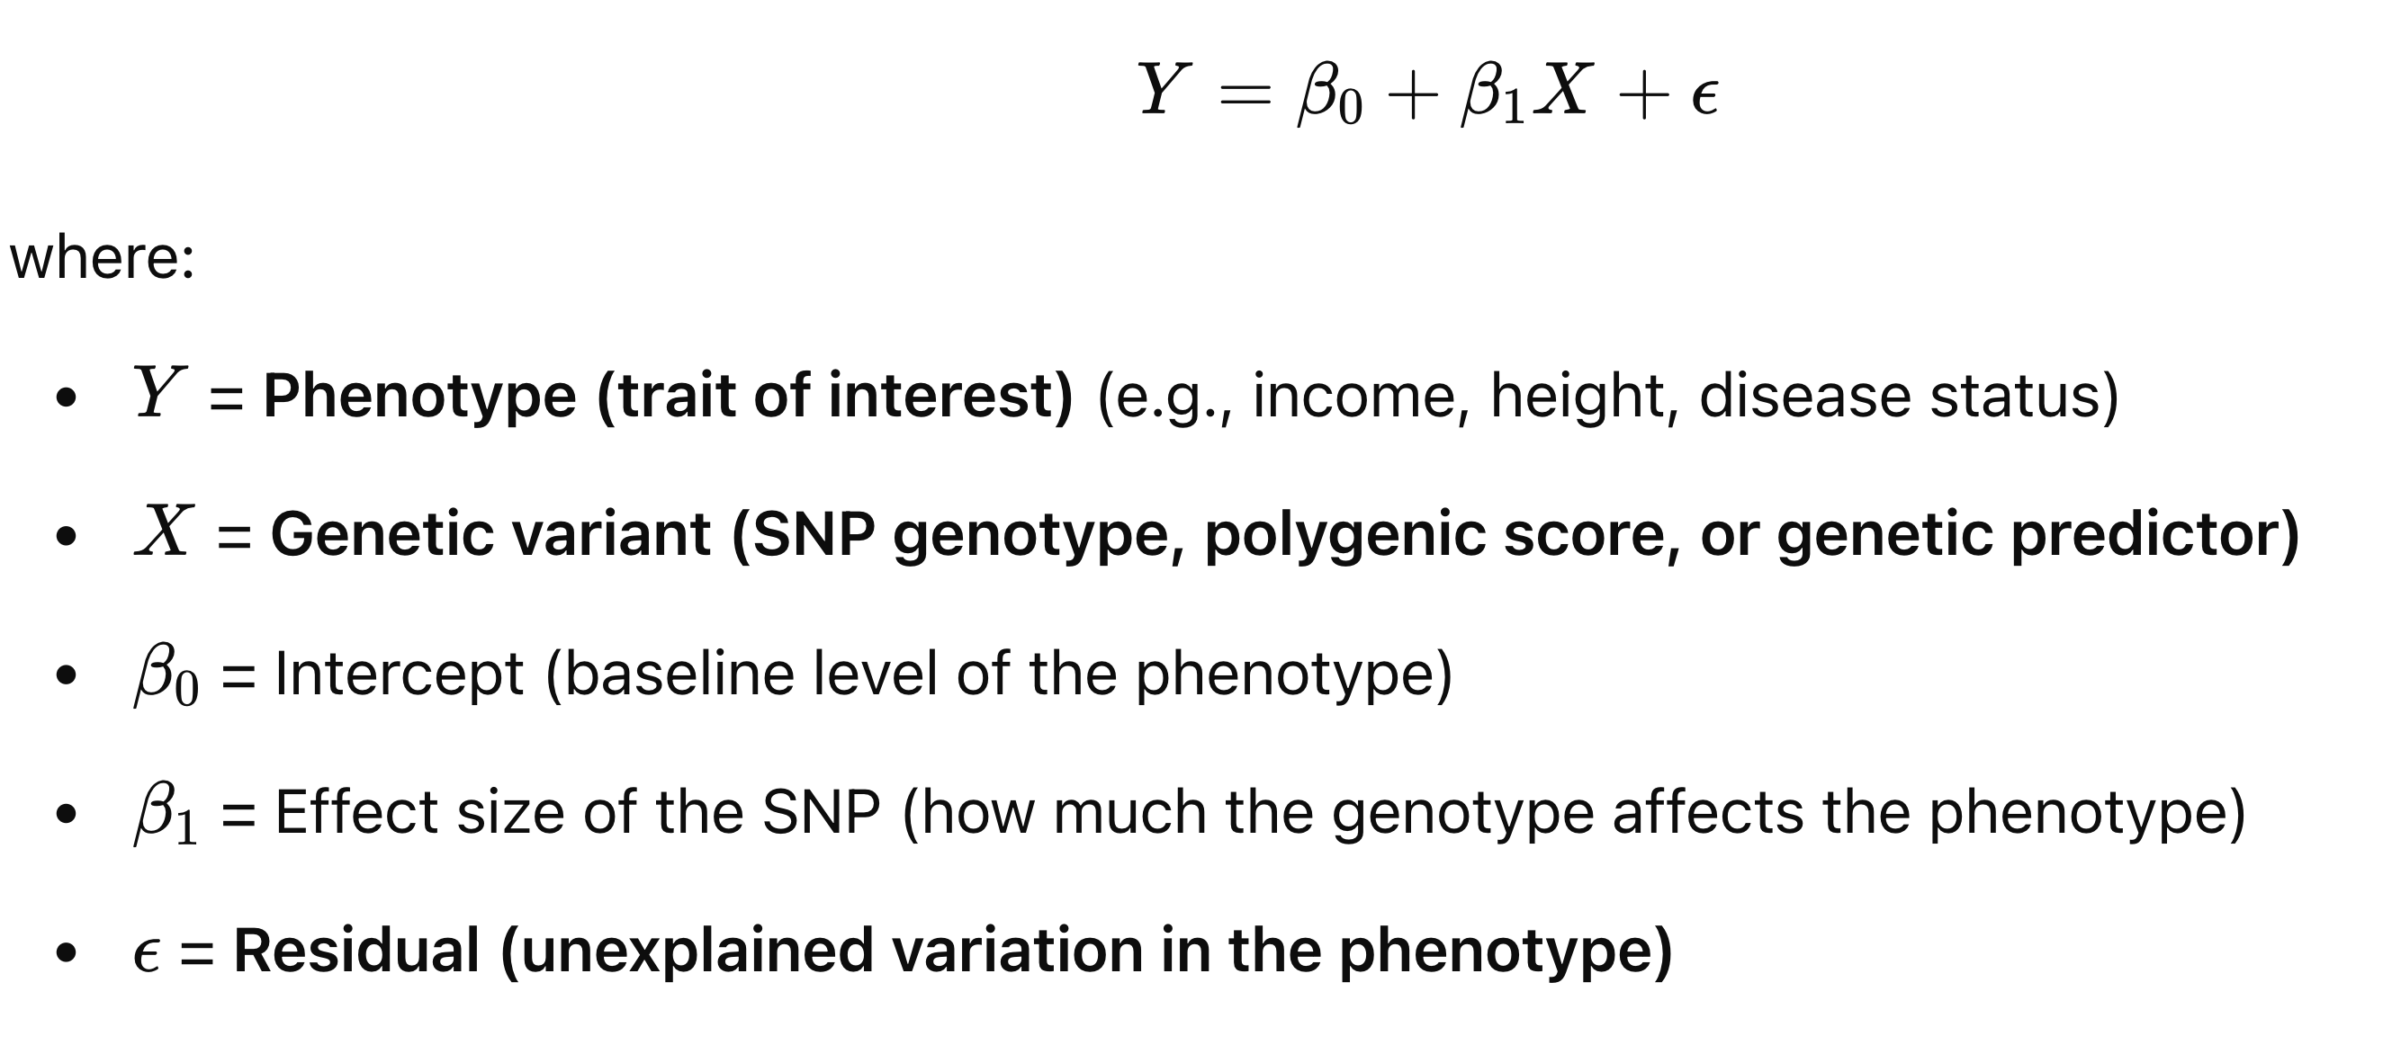
The Statistical Model of Genome-Wide Association Studies (GWAS)
In the context of genotypes and phenotypes
Possible reasons for a non-zero residual
- Population stratification
- Omitted environmental factors
- Gene-environment interaction
- Linkage disequilibrium confounding

Slide 5
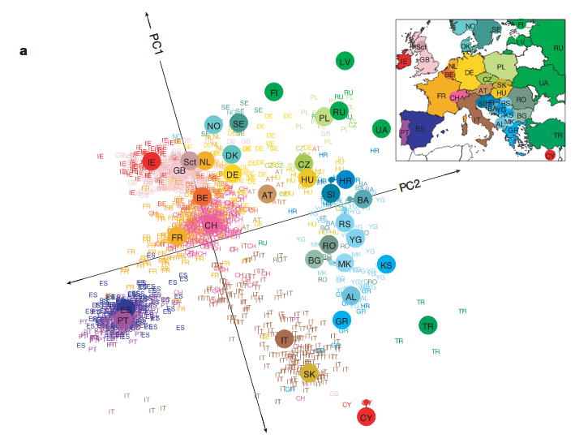
The Statistical Model of Genome-Wide Association Studies (GWAS)
Possible reasons for a non-zero residual
- Population stratification
- Omitted environmental factors
- Gene-environment interaction
- Linkage disequilibrium confounding
Solution: control for principal components (PCs) of genetic ancestry

Slide 6
The Statistical Model of Genome-Wide Association Studies (GWAS)
Possible reasons for a non-zero residual
If important environmental variables (e.g., parental income, education) are missing, they can confound the relationship between genes and the trait.
- Population stratification
- Omitted environmental factors
- Gene-environment interaction
- Linkage disequilibrium confounding
Solution: Use sibling comparisons or family-based designs to control for shared environmental effects.

Slide 7
The Statistical Model of Genome-Wide Association Studies (GWAS)
Possible reasons for a non-zero residual
Certain genetic effects can be mitigated/exacerbated by environment exposure.
Examples:
The APOE ε4 allele increases Alzheimer’s risk, but the effect is stronger in individuals with high saturated fat intake.
The FTO risk allele increases obesity risk, but the effect is reduced in physically active individuals.
Genetic variants linked to educational attainment have stronger effects in individuals from high social economic status families, likely due to better access to resources.
- Population stratification
- Omitted environmental factors
- Gene-environment interaction
- Linkage disequilibrium confounding
Solution: In addition to the main effect of environmental factors, include an interaction term.

Slide 8
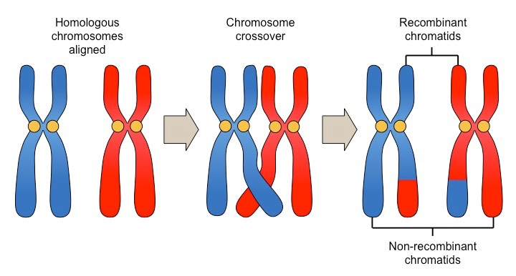
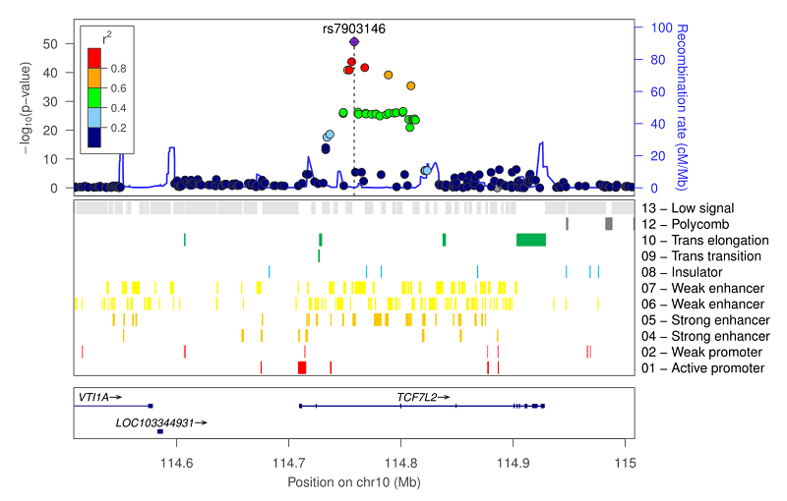
The Statistical Model of Genome-Wide Association Studies (GWAS)
Possible reasons for a non-zero residual
- Population stratification
- Omitted environmental factors
- Gene-environment interaction
- Linkage disequilibrium confounding
If a SNP is in LD with a causal SNP, the estimated effect might not reflect the true causal relationship.
Solution: Use fine-mapping or conditional analyses to separate independent signals.

Slide 9
The Statistical Model of Genome-Wide Association Studies (GWAS)
Possible reasons for a non-zero residual
- Population stratification
- Omitted environmental factors
- Gene-environment interaction
- Linkage disequilibrium confounding
If a SNP is in LD with a causal SNP, the estimated effect might not reflect the true causal relationship.
Solution: Use fine-mapping or conditional analyses to separate independent signals.

Slide 10
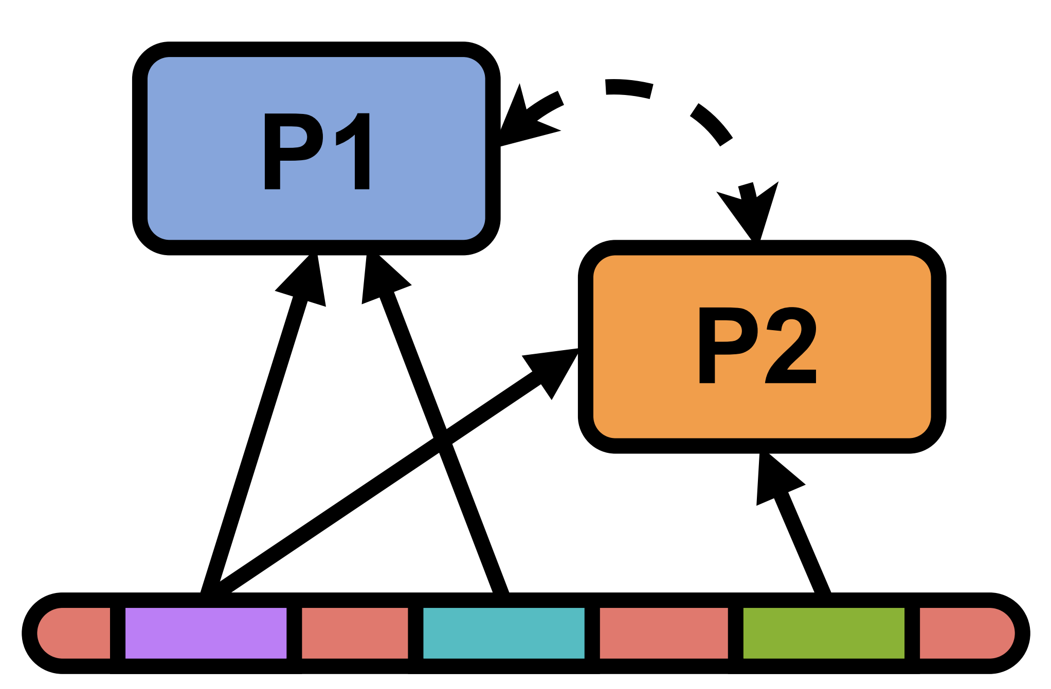
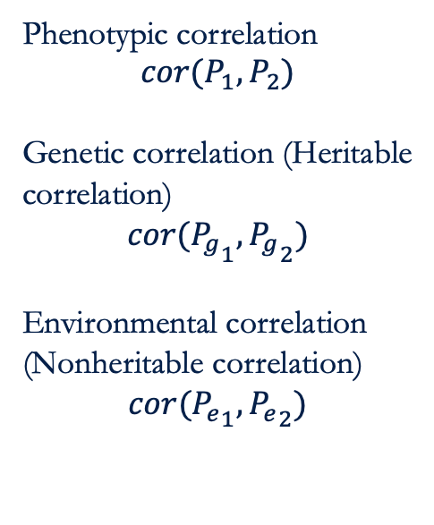

The Statistical Model of Genome-Wide Association Studies (GWAS)
$$P=P_{g}+P_{e}$$
Phenotypic correlation
$$cor(P_{1}, P_{2})$$
Genetic correlation (Heritable correlation)
$$cor({P_{g}}_{1}, {P_{g}}_{2})$$
Environmental correlation (Nonheritable correlation)
$$cor({P_{e}}_{1}, {P_{e}}_{2})$$

Slide 11
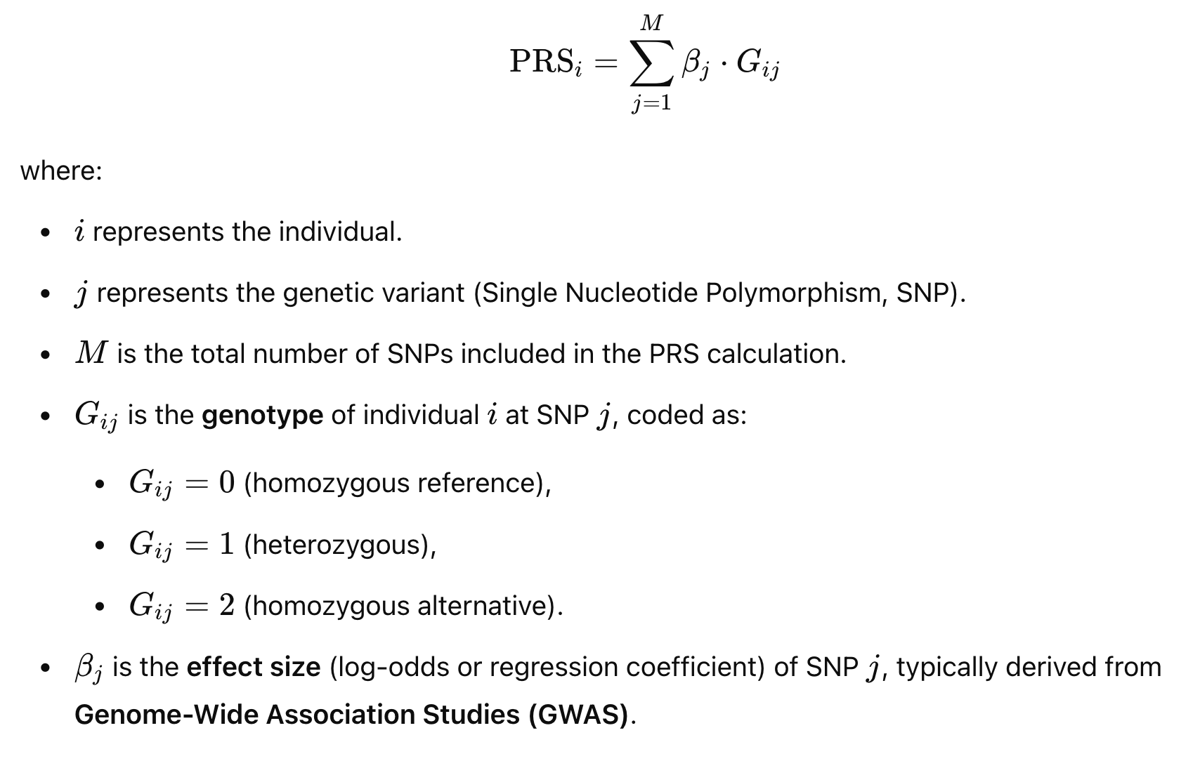
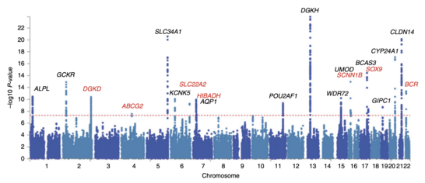
The Statistical Model of Genome-Wide Association Studies (GWAS)
Polygenic index prediction
Acquire trait-associating SNPs from GWAS

Slide 12
Study Overview
Genome-Wide Association Study (GWAS) on Income:
Conducted on 668,288 individuals of European descent.
Identified 162 genomic loci associated with a common genetic factor underlying income measures.
Polygenic Index Prediction (PGI)
Phenome-wide association study of higher income-related genetic index.

Slide 13
Study Overview
Hypothesis | Expected Outcome
1. Genetic variants are associated with income | Certain SNPs will be linked to income levels in a GWAS.
2. Income has a polygenic basis | Many loci with small effect sizes contribute to income variance.
3. Genetic component of income is correlated with EA | High genetic correlation between income and EA.
4. Environmental factors mediate genetic effects on income | Societal conditions influence how genetic predispositions affect income.
5. Income-related genes are linked to health outcomes | Higher income PGI predicts lower disease risk.
6. Some genetic effects on income remain after controlling for EA | A residual genetic signal exists for income beyond EA.
7. Gene-environment interactions influence genetic effects on income | Genetic effects differ across social and economic contexts.
8. Income PGI reflects indirect parental genetic effects | Only ~25% of genetic effects on income are direct, while 75% are indirect.

Slide 14
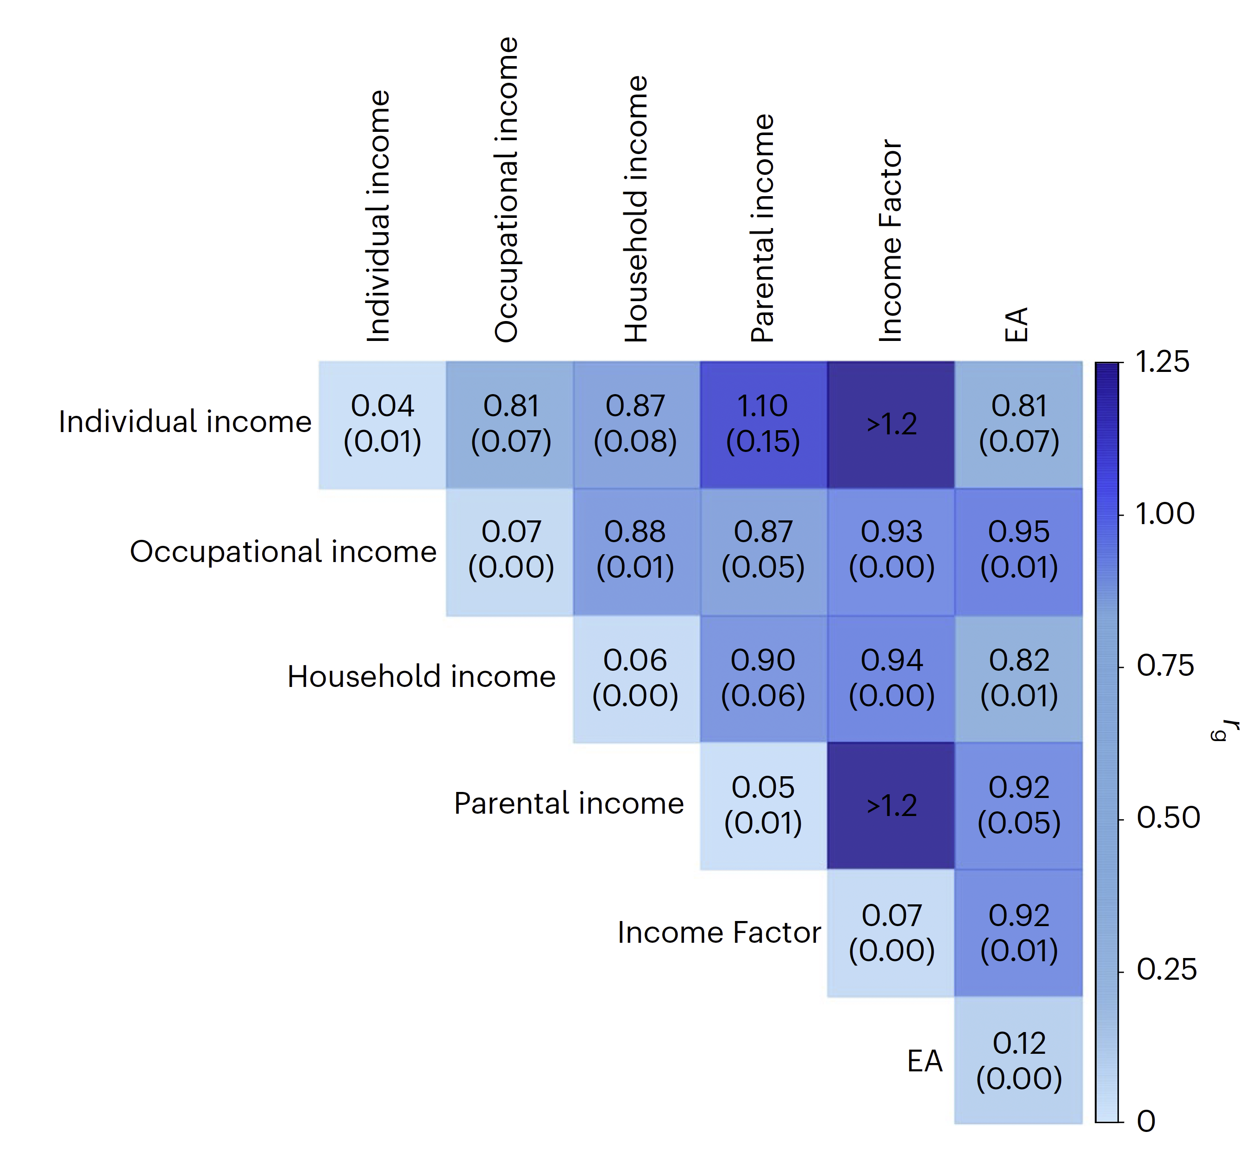
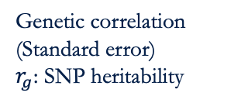
Genetic correlation of income measurements
Genetics strongly influences income, but largely through education.
Parental income and family background play a key role in income-related genetic effects.
Individual income has lower SNP heritability, indicating that environmental and social factors heavily influence earnings.
Out-of-bound estimates suggest technical challenges in genetic correlation estimation, requiring careful interpretation.
Genetic correlation (Standard error)
$r_{g}$: SNP heritability

Slide 15
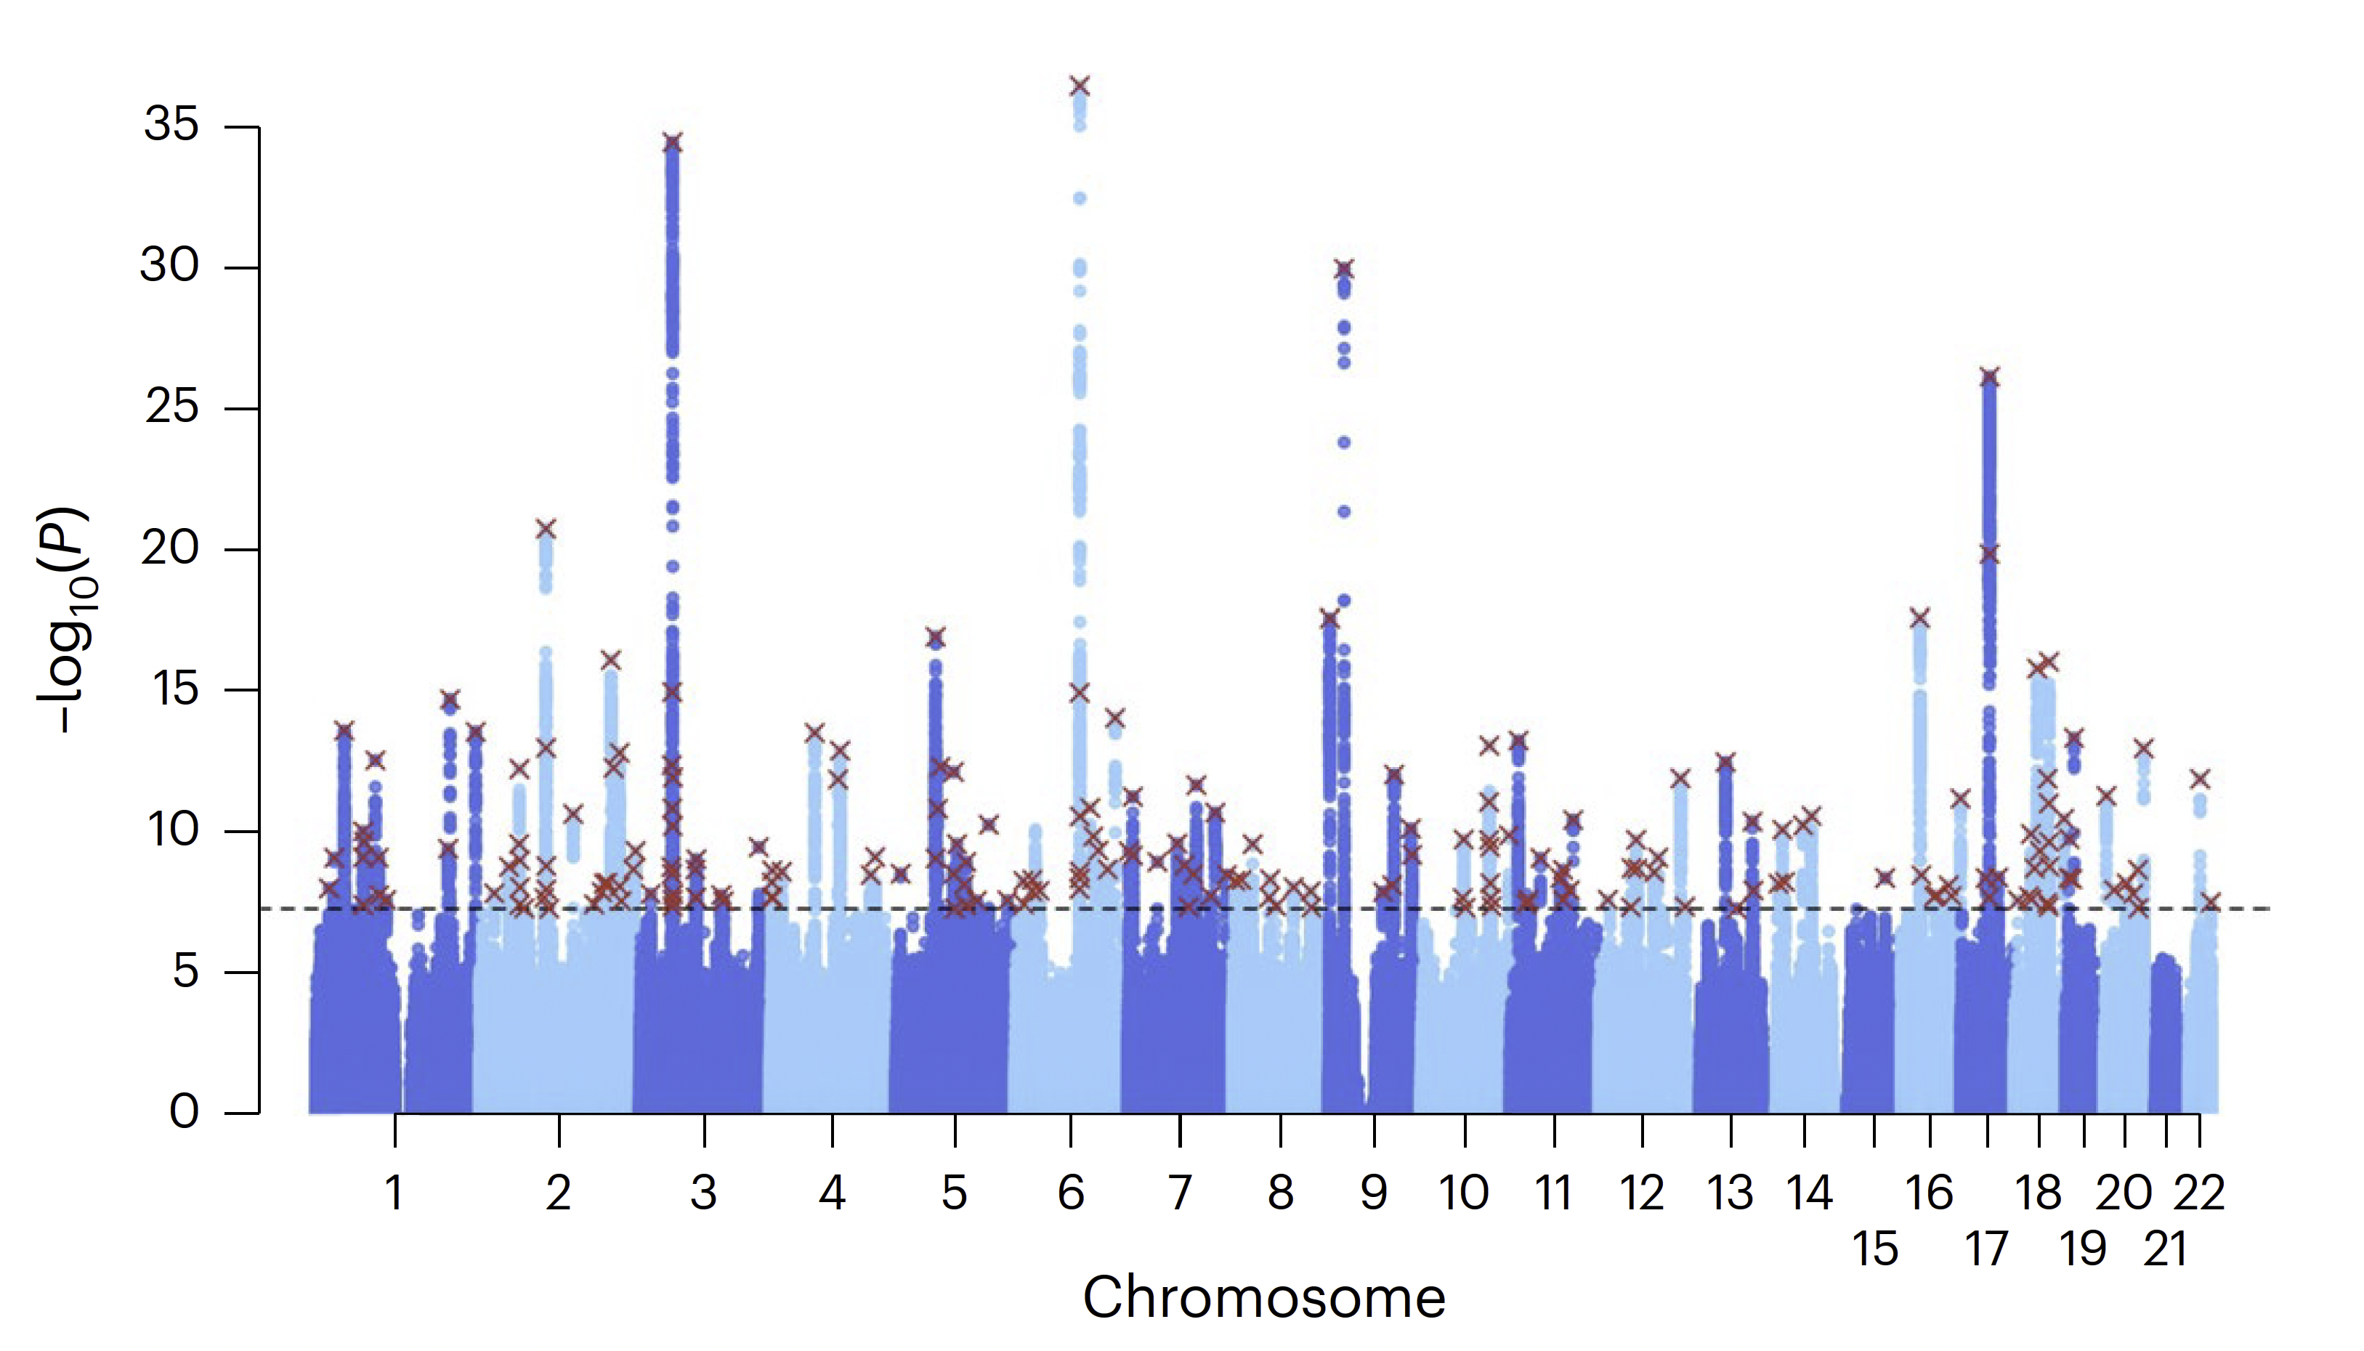
GWAS of income
x Lead SNP found from fine-mapping analysis
162 significant loci determined
Polygenic
Most loci come with modest effect size

Slide 16
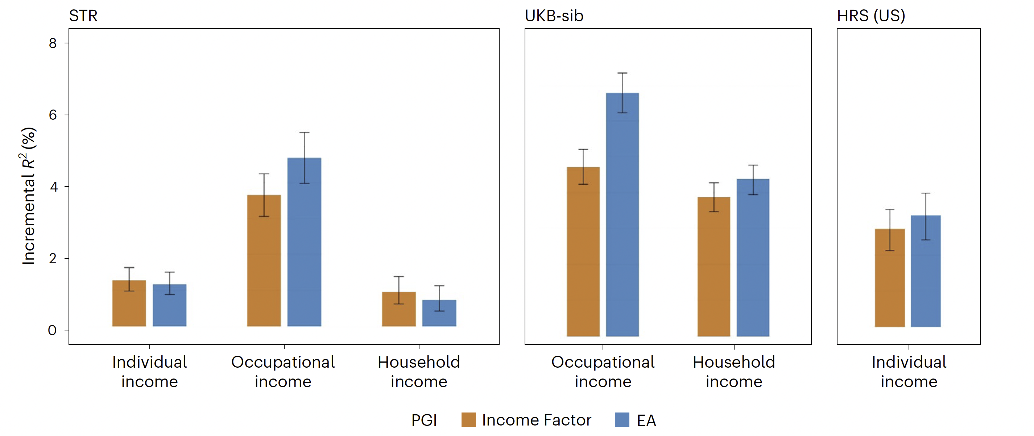
Polygenic prediction of income measures

Slide 17
Polygenic prediction of income measures
Finding | Interpretation
EA PGI explains more variance in income than Income Factor PGI | Genetic effects on income act primarily through education.
Higher heritability for occupational vs. individual income | Stable career-related earnings are more influenced by genetics than short-term individual earnings.
Genetics predicts household income more than individual income | Indirect genetic effects from family background play a role in economic outcomes.
Cross-dataset reproducibility with effect size differences | Genetic effects on income are consistent but vary depending on socioeconomic conditions.

Slide 18
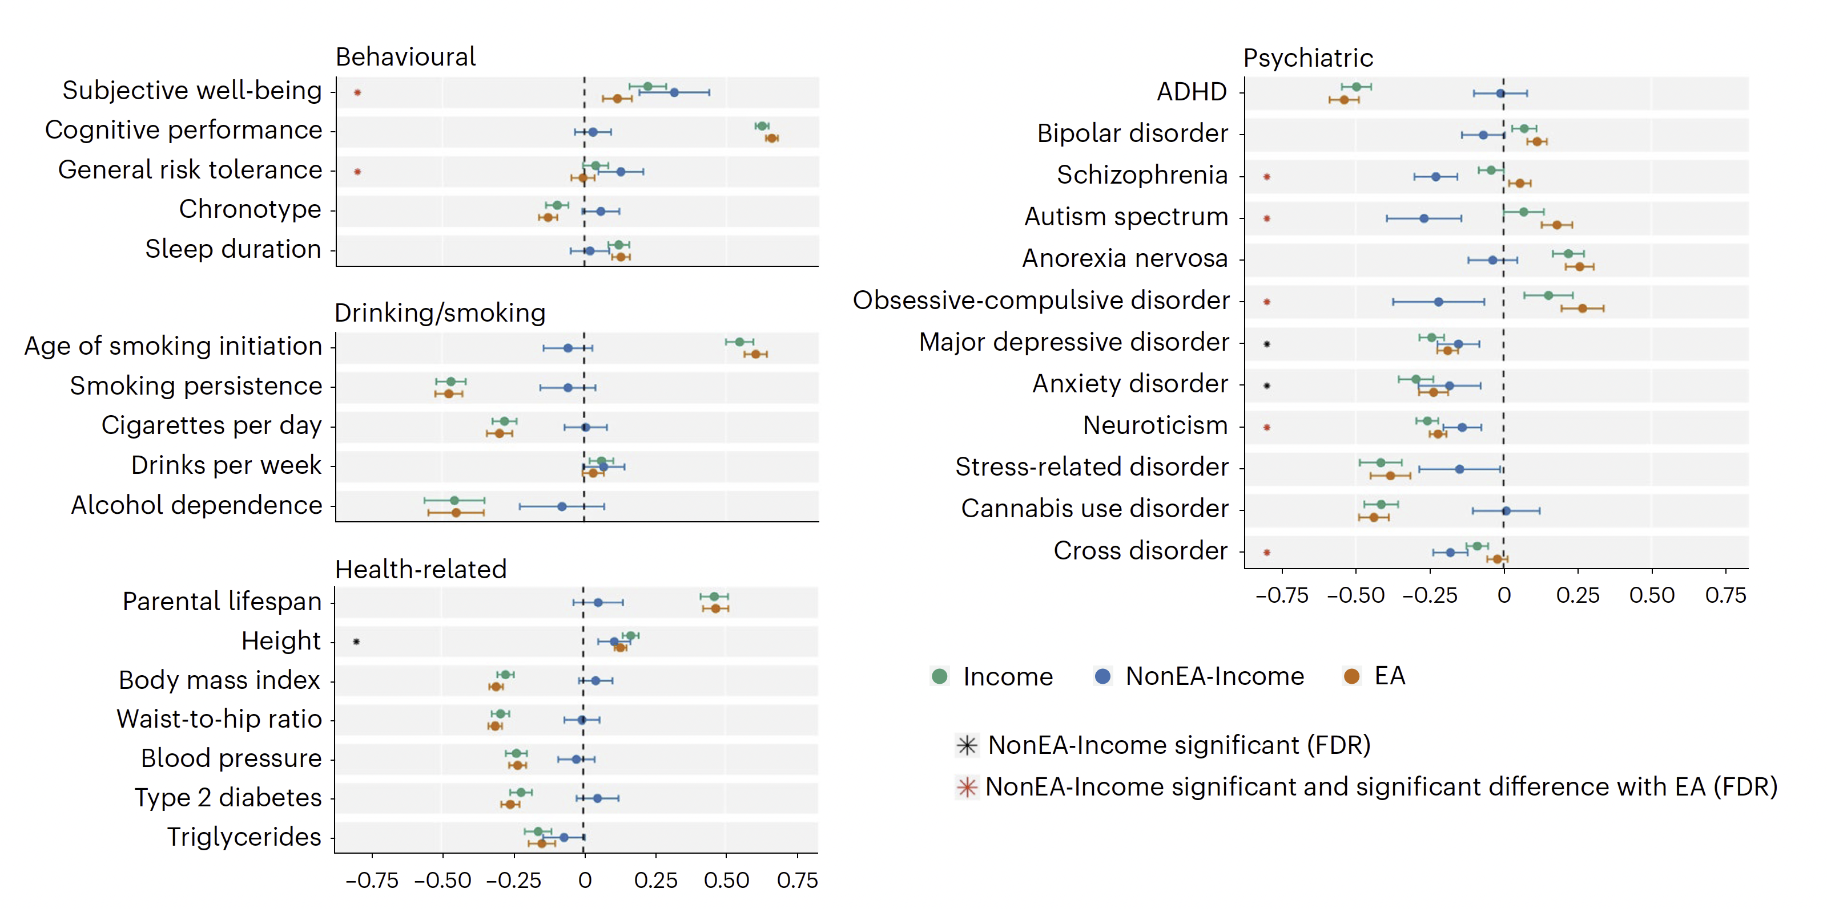
Genetic correlation estimates with health outcomes

Slide 19
Genetic correlation estimates with health outcomes
Finding | Interpretation
Income and NonEA-Income PGIs correlate with health, smoking, and drinking behaviors | Supports the socioeconomic health gradient: higher income-associated genetics predict better health and lower risky behaviors.
NonEA-Income shows distinct psychiatric associations from EA | Suggests that genetic factors influencing income beyond education are linked to lower schizophrenia and autism risk.
Higher genetic predisposition to income is linked to better cognitive function and subjective well-being | Suggests that both education and non-education-related pathways contribute to income via cognitive and psychological traits.
Genetic factors linked to income correlate with reduced psychiatric risks and better mental health | Income-related genetics may reflect both personal and environmental influences on well-being.

Slide 20
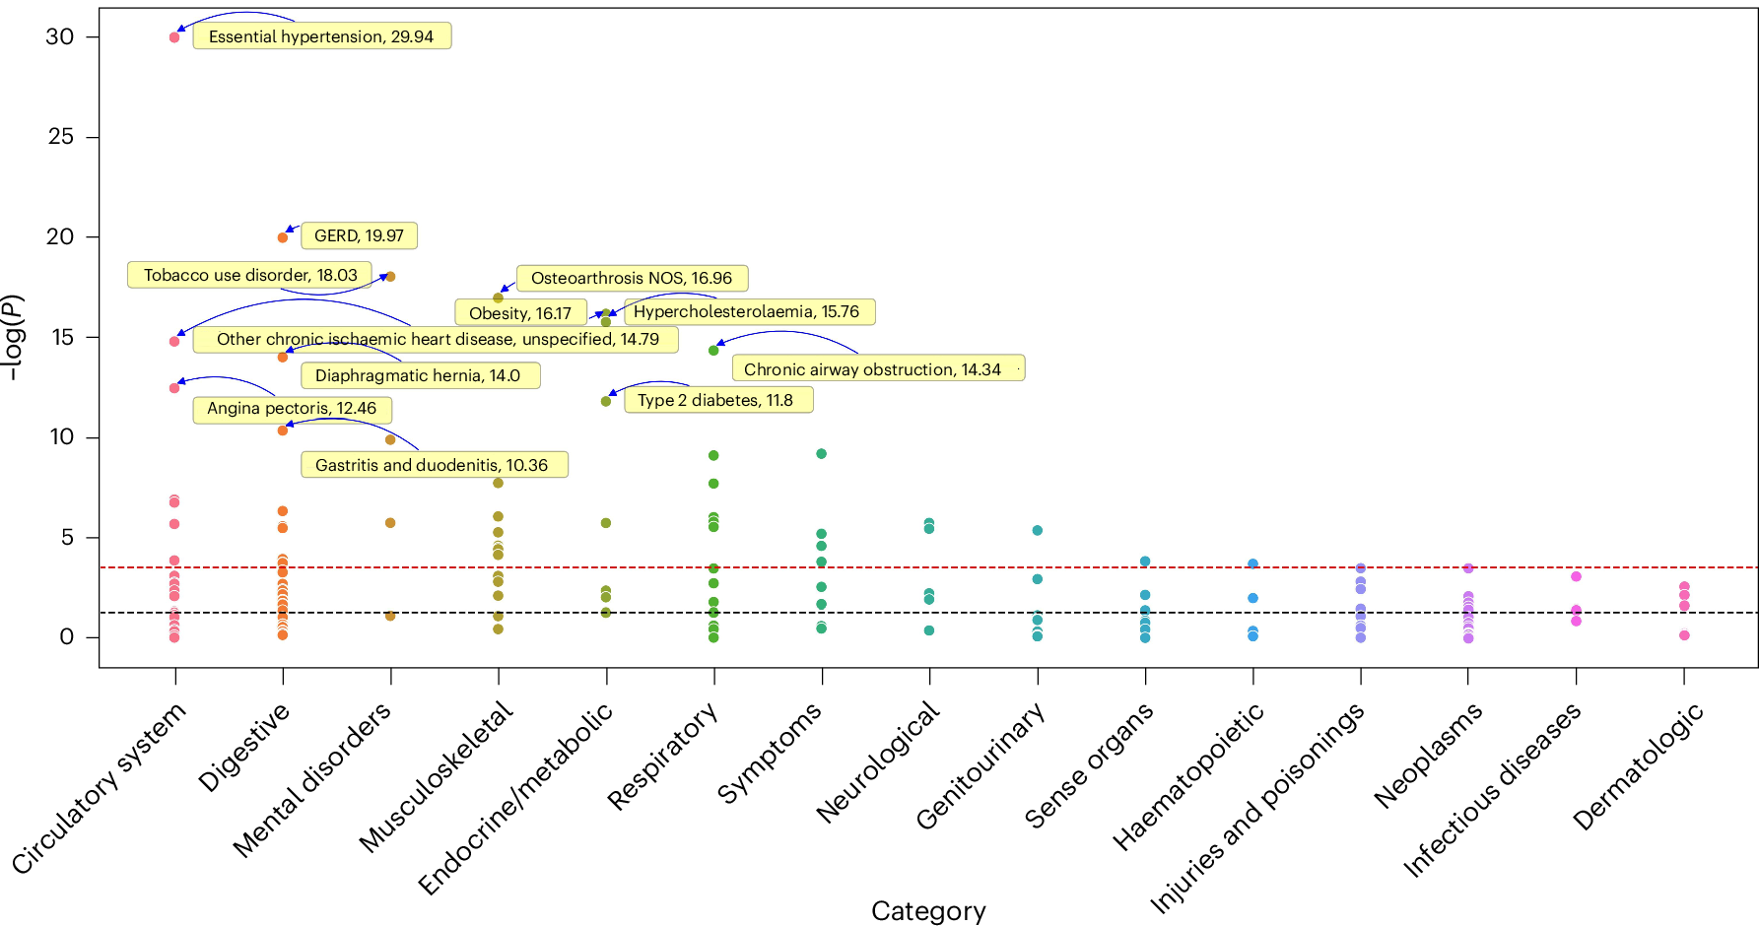
Phenome-wide association study of the Income Factor PGI
Income PGI is associated with multiple diseases
Top associations are cardiovascular, metabolic, and lifestyle-related (smoking, alcohol, etc.) diseases

Slide 21
Conclusion
- Polygenic index (PGI) of income explains 3 – 5% of the variation in occupational and household income
- Occupational income is more strongly predicted by genetics, suggesting that genetic effects are more stable when considering long-term career earnings rather than short-term individual fluctuations.
- Environmental factors play a major role, with genetics having a weaker direct effect on income when family background is accounted for
- Income-Associated Genetic Variants Are Linked to Better Health Outcomes
- NonEA-Income Captures Unique Genetic Effects Beyond Education
- Gene-Environment Interactions Likely Influence Income Outcomes
Notes:
1. Income Has a Detectable Genetic Component, but It Is Strongly Mediated by Education
Genome-wide association analysis identified genetic loci associated with income, but most of these loci overlap with those linked to educational attainment (EA).
Genetic correlation between income and EA is extremely high (~0.92), meaning that the majority of genetic effects on income act through educational pathways rather than directly influencing earnings.
Only ~25% of the genetic influence on income is direct, while the remaining 75% is explained by indirect genetic effects, such as parental environment and educational opportunities.
2. Income Polygenic Scores (PGIs) Predict Economic Success but with Modest Effect Sizes
The polygenic index (PGI) for income explains 3-5% of the variance in occupational and household income.
Occupational income is more strongly predicted by genetics than individual income, suggesting that genetic effects are more stable when considering long-term career earnings rather than short-term individual fluctuations.
Sibling analyses confirm that environmental factors play a major role, with genetics having a weaker direct effect on income when family background is accounted for.
3. Income-Associated Genetic Variants Are Linked to Better Health Outcomes
Higher income-related polygenic scores are associated with better physical and mental health, including:
Lower risk of obesity, hypertension, diabetes, and cardiovascular diseases.
Lower risk of depression, schizophrenia, and anxiety.
Lower likelihood of engaging in risky behaviors like smoking and heavy drinking.
This reinforces the socioeconomic health gradient, where income, health, and genetic factors are intertwined.
4. NonEA-Income Captures Unique Genetic Effects Beyond Education
The study separates income-associated genetic variants that are independent of EA ("NonEA-Income").
NonEA-Income shows distinct associations with mental health and personality traits, including:
Lower schizophrenia and autism risk compared to EA.
More associations with risk-taking behaviors and decision-making traits.
This suggests that some genetic effects on income act through non-cognitive pathways, such as personality, risk tolerance, or social behaviors.
5. Gene-Environment Interactions Likely Influence Income Outcomes
The genetic effect on income is context-dependent, varying across countries, social structures, and labor market conditions.
This suggests that gene-environment interactions (G×E) play a role, where genetic effects on income are amplified or diminished depending on socioeconomic conditions.
6. Genetic Influence on Income Operates Through Family and Social Pathways
Parental income and household income show stronger genetic effects than individual income, indicating that family resources shape economic success.
Indirect genetic effects (genetic nurture)—where a parent’s genes influence their child’s income via family wealth, education, and opportunities—are significant.
Sibling-based analyses confirm that a large proportion of the genetic effect on income is due to shared family environments rather than purely individual genetic differences.

Slide 22
Bigger picture
- Genetics alone does not dictate economic success - education, family background, and societal factors are crucial.
- Genetic effects on income operate through social and environmental pathways, highlighting the importance of education policies, economic structures, and interventions to reduce inequalities.
- Public policies aiming to enhance socioeconomic mobility should focus on educational access and reducing environmental barriers

